Slide 1
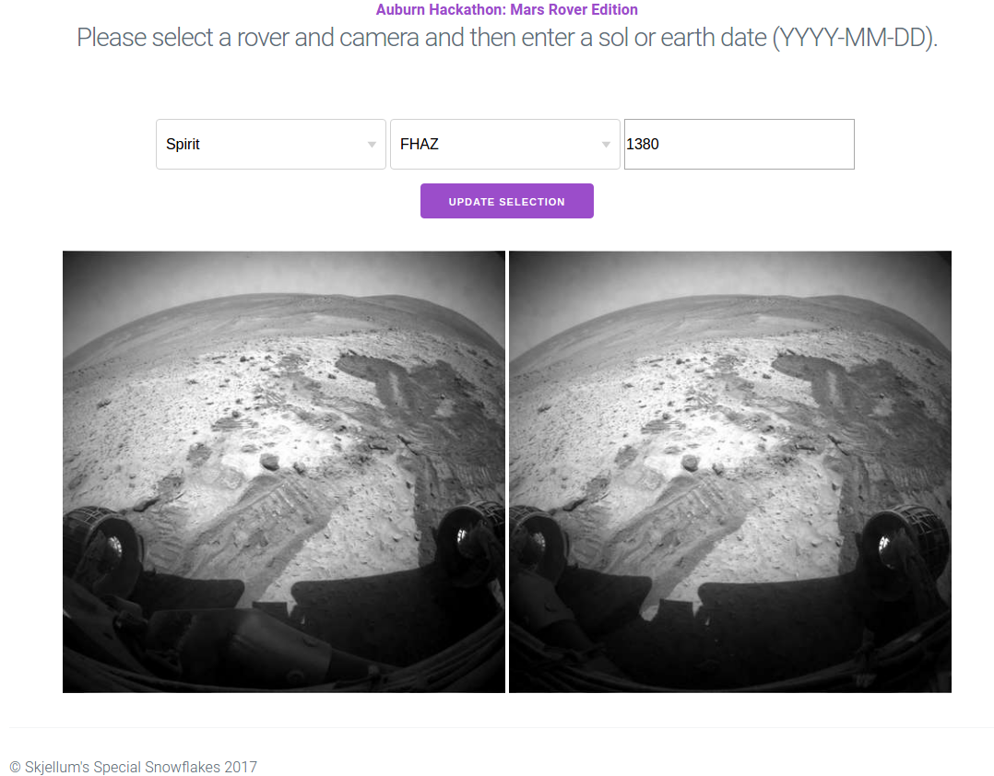
Tech Stack:
Flask
SQLAlchemy
SQLite
Requests
HTML
CSS

